Slide 1
SQL Server 2000 Internals
Query Processor
Ramkumar Murugesan

Slide 2
Query Processor
Compilation
Optimization
Finding Optimized Plan
Generating Execution Plans

Slide 3
Next Section>>>
Compilation

Slide 4
Compilation
During compilation, SQL Server parses each statement and creates a sequence tree
The sequence tree is then normalized
Normalization includes
  Verifying existence of tables and columns
  Loading the metadata for the tables and columns
  Adding information about implicit conversions
  Replacing references to a view with the definition of that view
  Creates query graph which is optimized to produce a plan

Slide 5
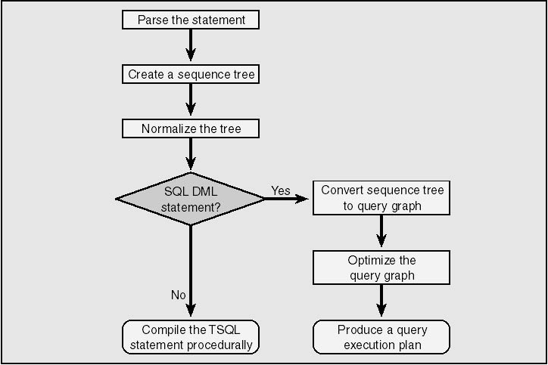
Compilation

Slide 6
Next Section>>>
Optimization

Slide 7
Optimization
SQL Server's query optimizer is a cost-based optimizer
Each possible execution plan has an associated cost
Optimizer analyzes the possible plans and chooses the one with lowest cost
Cost = Amount of time to return results with the available computing resources
The query optimizer chooses the plan that most quickly returns results to the user with a reasonable cost in resources

Slide 8
Next Section>>>
Finding Optimized Plan

Slide 9
Finding optimized plan
If there is only one possible plan for a query, SQL Server would generate that plan and stops looking for a better plan
If more than one plan found, Trivial plan optimizer finds simple plans that are inexpensive
If no simple plan found
  syntactical transformations of query is performed
  Statistics for indexes are loaded
  Optimizer goes through a series phases of cost based optimization
If no cheap plan found in the preliminary phases, the best cost so far is compared with a threshold value
If Cost > threshold value, optimizer goes for full optimization
Note: The threshold value is defined in sp_configure

Slide 10
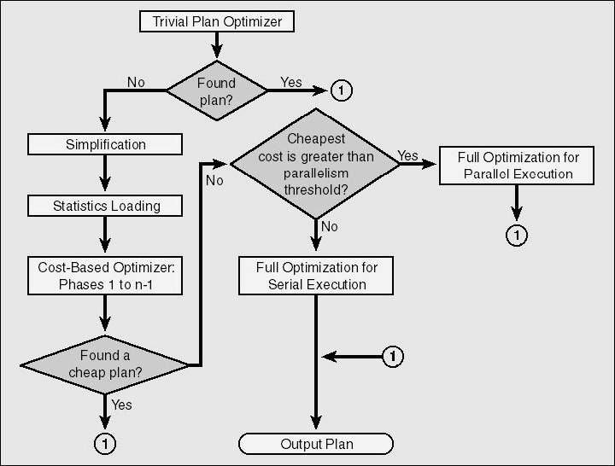
Finding optimized plan

Slide 11
Next Section>>>
Query Optimization
Topics…
How does Query Optimizer Works | Query Analysis | Index Selection | Join Selection

Slide 12
How Query Optimizer Works
Query Optimizer estimates a cost for every combination of join strategy, join order, and indexes
Then, the number of logical reads and the memory resources that are required and available are estimated
Then the optimizer compares the cost of each plan and chooses the plan with the lowest estimate
Query optimization happens in three main steps…
  Query analysis
  Index selection
  Join selection

Slide 13
Next Section>>>
Query Analysis
Topics…
SARGable Clauses | Index Scan and Seek | Examples

Slide 14
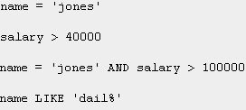
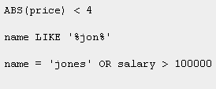
Query Analysis – SARGable Clauses
Query Optimizer first looks for SARGable clauses in the query
Search Argument contains a constant expression that acts on a column by an operator. Examples are…
Only SARGable clauses make use of indexes
Sargable operators include =, >, <, =>, <=, BETWEEN, and sometimes LIKE
Non-SARGable clauses include, if column appears on both sides, if OR condition appears, if operators use NOT condition
One index can be used for many SARG if they are AND'ed together

Slide 15
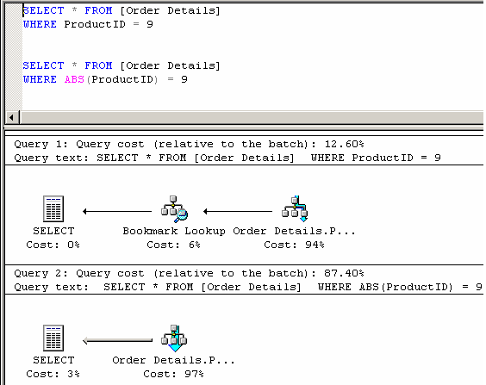
Query Analysis – Examples
ProductID column has a non-clustered index
In First query, Optimizer uses NCI to retrieve rows as the clause is SARGable
In Second query, because of the presence of the function ABS, there is no SARG and the index on ProductID is not even considered and table scan occurs

Slide 16
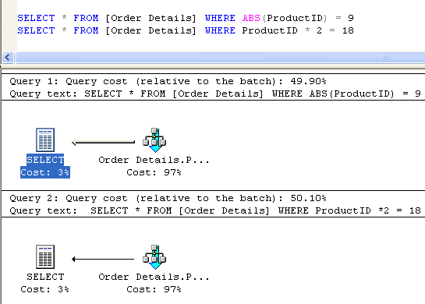
Query Analysis – Examples
In the 3rd query, optimizer internally converts the WHERE condition into SARG and estimate the number of rows
Conversion happens only during optimization; during execution, it is not possible to multiply 2 at every step in the index tree and so goes for scan

Slide 17
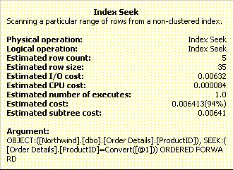
Query Analysis – Examples
In the first Query, index seek is used to retrieve rows
In Index Seek, SQL Server will traverse the index from the root down to the leaf level, comparing the values in the SARG to the key values in the index rows to determine which page to look at next.
Seeking through an index typically means a root-to-leaf traversal

Slide 18
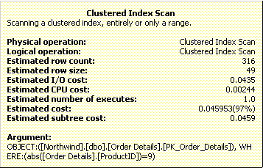
Query Analysis – Examples
In the second query, clustered index scan is used to retrieve rows
In CI scan, SQL Server will stay at the leaf level and traverse just that one level of the index from the first page to the last
Seek is vertical traversal of an index and a scan a horizontal one
Scanning the clustered index means scanning the table
Estimated Row count shows 316 rows (Table row count is 2155)
The index statistics were not used, and optimizer took a wild guess

Slide 19
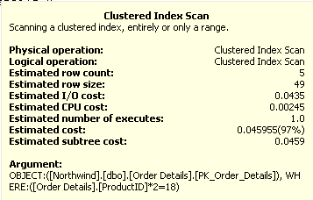
Query Analysis – Examples
Row count is the same as in the first query
The statistics are used
But the operation to be performed is the index scan of the clustered index
When you used an expression that was convertible to a SARG, the optimizer could examine the statistics, even if the index itself couldn't be used during execution

Slide 20
Next Section>>>
Index Selection
Topics…
Index Selection | Index Statistics | Index Cost

Slide 21
Index Selection
Second phase of query optimization.
The different sub-phases…
  Index Selection: The query optimizer determines whether an index exists for a sargable clause
  Index Statistics: Assesses the index's usefulness by determining the selectivity of the clause.
    Selectivity = Number of rows returned by the query with the where clause
  Index Cost: Estimates the cost of finding the qualifying rows

Slide 22

Index Selection
An index is useful if its first column is used in the SARG with bound values
Index will still be useful if the remaining columns excluding the first column are used in the SARG
An index that contains all the referenced columns is called a covering index and is one of the fastest ways to access data
Say, If Employee table has a CI on EmployeeID and NCI on LastName, FirstName. The below query uses covering index
Since CI is a part of NCI’s bookmark, EmployeeID gets covered in the index

Slide 23
Next Section>>>
Index Statistics
Topics…
Density | Storing Statistics | DBCC SHOW_STATISTICS | Summary

Slide 24
Index Statistics
Statistics are a histogram consisting of an even sampling of values for the index key based on the current data
If the index is composite, Sampling is done on the first key column
The histogram (stored in the statblob field of the sysindexes table) is created when the index is created on existing data
If the index is created when table is empty, no statistics appear
SQL Server detects automatically whether statistics are not up-to-date and updates them during query optimization (if auto_update statistics is enabled)
Values can be refreshed manually by running UPDATE STATISTICS

Slide 25
Index Statistics - Density
Density is the uniqueness of the data values encountered
Provides a measure of how selective the index is
Density values range from 0 through 1
Density = 1/cardinality of index keys
  Cardinality => unique values in the index
Highly selective indexes have density values of 0.10 or lower.
A unique index on a table with 8345 rows has a density of 0.00012 (1/8345)
If a non-unique non-clustered index has a density of 0.2165 on the same table, each index key can be expected to point to about 1807 rows (0.2165 × 8345)

Slide 26
Index Statistics - Storing Statistics
Statistics for a single column index consist of one histogram and one density value
The multicolumn statistics for one set of columns in a composite index consist of one histogram for the first column in the index and density values for each prefix combination of columns
This density information helps the optimizer to decide how useful the index is for joins
The histogram contains up to 200 values of a given key column

Slide 27
Index Statistics - Storing Statistics
In addition to histogram, statblob field in sysindexes would contain
  The time of the last statistics collection
  The number of rows used to produce the histogram and density information
  The average key length
  Densities for other combinations of columns
Example: Create a NCI as shown below…
The existing CI is also considered part of the key in every NCI key row
To display this information, Use DBCC SHOW_STATISTICS command

Slide 28
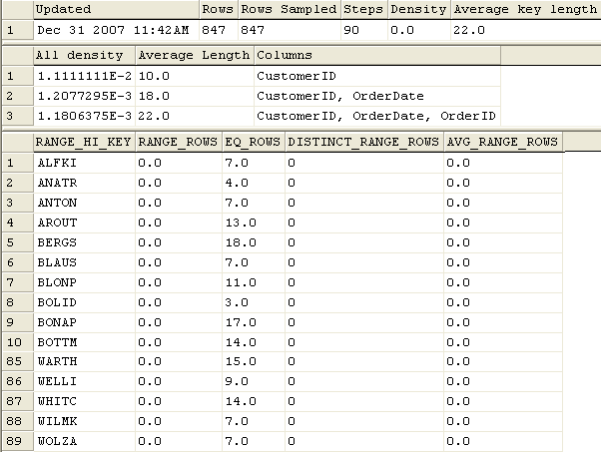
Index Statistics – DBCC SHOW_STATISTICS

Slide 29
Index Statistics – DBCC SHOW_STATISTICS
Updated column – Latest date on which statistics are updated
Rows – Row count of the table
Rows Sampled – Rows that were considered for producing statistics
Step – The range of key values between each sample value
Average Key Length – This includes clustered index key length
The next section shows the density for each key values
  There are 90 different values for CustomerID, so the density is 1/90 = 0.011111
  There are 828 different values for CustomerID and OrderDate combination, so the density is 0.0012077
  The CustomerID, OrderDate and OrderID combination is unique and so the density would be 0.0011806

Slide 30
Index Statistics – DBCC SHOW_STATISTICS
The sample value is the endpoint of the range
Three values are stored along with each step
  EQ_ROWS - number of rows that have a value equal to that sample value
  RANGE_ROWS - specifies how many other values are inside the range (between two adjacent sample values)
  RANGE_DENSITY - number of distinct values
Below values are displayed instead of the RANGE_DENSITY
  DISTINCT_RANGE_ROWS - the number of distinct rows inside this range (excluding RANGE_HI_KEY). This is computed as 1/RANGE_DENSITY.
  AVG_RANGE_ROWS - the average number of rows per distinct value, computed as RANGE_DENSITY * RANGE_ROWS
The statblob column stored 200 sample values
Output

Slide 31
Index Statistics - Summary
The query optimizer uses statistics on both indexed and unindexed columns to determine the most appropriate processing strategy for any particular query.
Whenever an index is created on a table containing data, the query optimizer collects statistics and stores them for that index in sysindexes.statblob
By default, the statistics are automatically updated whenever the query optimizer determines that they are out-of-date
In addition, the query optimizer generates statistics on columns used in SARGs when it needs them, and it updates them when needed
To view the statistics maintenance Algorithm: http://support.microsoft.com/kb/195565

Slide 32
Index Cost
Index cost calculation Components
  Amount of logical I/O needed
  Cache-Hit Ratios
The optimizer calculates index cost by the following algorithm…
  Evaluates indexes to estimate the number of likely "hits" based on the density and step values in the statistics
  Based on these values, it estimates how many rows qualify for the given SARG and how many logical reads would retrieve those qualifying rows
Estimated number of logical reads varies for each access method
Using an index to find qualifying rows is frequently referred to as an index driving the scan

Slide 33
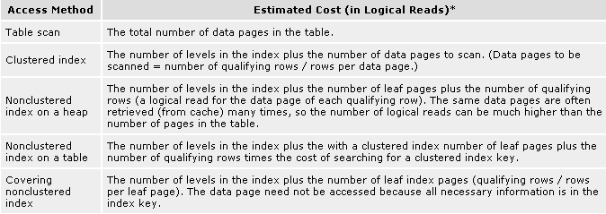
Index Cost
When a non-clustered index drives the scan, the query optimizer assumes that the page containing each identified qualifying row is probably not the same page accessed the last time
If the scan is driven from a clustered index, the next row is probably located on the same page as the previous row
Figure: The cost of data access for tables with different index structures

Slide 34
Next Section>>>
Join Selection
Topics…
Cost Calculation | Nested Loop Join | Merge Join | Hash Join

Slide 35
Join Selection
Third Step in Query Optimization
For Queries using multiple-table or self-join, the query optimizer evaluates join selection and selects the join strategy with the lowest cost.
Cost Calculation -
  the expected number of reads
  the amount of memory required
Three Join Strategies
  Nested Loop Joins
  Merge Joins
  Hash joins
Tables to be joined are called the join inputs

Slide 36
Join Selection - Nested Loop Joins
Common type of join
A set of loops that take a row from the first table and use it to scan the joined table and so on
This step is reiterated until the result that matches is used to scan the last table
The number of iterations through any of the loops equals the number of scans that must be done
Scans are not table scan. It either uses index or hash join strategy to retrieve rows
The result set is narrowed down as it progresses from table to table within each iteration in the loop

Slide 37

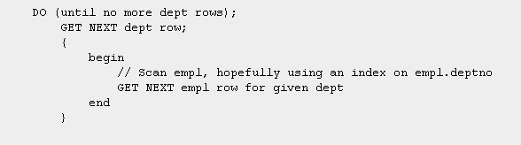
Join Selection - Nested Loop Joins
For example, for the below query,
The pseudo code will be as follows…

Slide 38

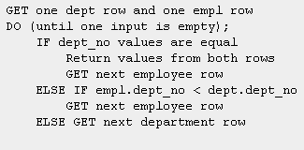
Join Selection - Merge Joins
If tables are joined on clustered indexes, or if the tables are pre-sorted on join column, Merge join is used
Merge joins simply merge two sorted lists of values
If there are duplicates, of the inputs must rewind to the start of the duplicates as each duplicate from the other input is processed
Example…
Pseudo code of merge join

Slide 39
Join Selection - Hash Joins
Used when no indexes exist on join column on either input
Hashing divides the existing data into groups based on some property
Puts all the data with the same value in hash bucket
To retrieve rows, the appropriate bucket needs to be looked in
When joining two tables, SQL Server uses one table, (build input) to build the hash buckets
Then, one row at a time, it inspects the other table and tries to find a match in the existing buckets. The second table is called the probe input

Slide 40

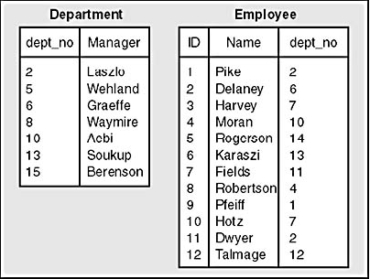
Join Selection - Hash Joins Example
For processing hash joins, SQL Server use the smaller input as the build input
We assume that the hash buckets have been built based on the department table values
The buckets are actually stored as linked lists
In this case, all we have to keep track of is the department number and manager name
The collection of these linked lists is called the hash table

Slide 41
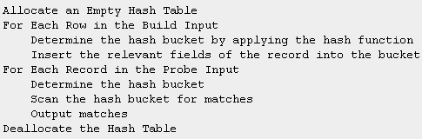
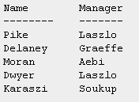
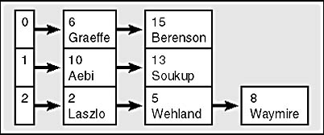
Join Selection - Hash Joins Example
The Pseudo code for hash join is shown here ➔
Consider, we use modulo 3 as the hash function and join the tables
Applying the algorithm and mod to our two inputs, the expected output would be ➔
A hash table built from the smaller (build) input is shown here ➔

Slide 42
Next Section>>>
Other Processing Strategies
Topics…
Group By Operations | Distinct Operations | Union Operations

Slide 43
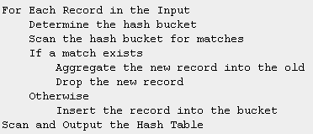
GROUP BY Operations
In SQL Server 2000, Query optimizer chooses hashing technique to organize the data into groups and compute aggregates
If GROUP BY uses hashing, order of the data depends on the order in which records appear in the hash buckets
GROUP BY doesn’t sort data. Only ORDER BY does that
The pseudo code for Group By that uses a hashing function is shown here ➔

Slide 44
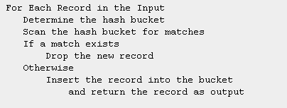
Distinct Operations
Introduced in SQL Server 2000
Same as Group by
Only difference is, Distinct doesn’t have any aggregate clause
The Pseudo code is shown below…
Tip: For GROUP BY, DISTINCT, and UNION operations, let the query optimizer decide whether to use hashing or sorting and merging

Slide 45
UNION Operations
The UNION operator in SQL Server has two variations for combining the result sets of two separate queries into a single result set.
For UNION ALL, SQL Server returns all rows from both inputs as the final result
For UNION, SQL Server removes any duplicates before returning the results.
To remove duplicates, UNION uses hashing, just like DISTINCT;
UNION can happen in two ways…
  Sorts the inputs and then merges them
  Concatenate the inputs and then sort them

Slide 46
Next Section>>>
Generating Execution Plans
Topics…
Execution Plans | Memory Grant Scheduler | Opening the plan and Executing

Slide 47
Generating Execution Plans
The end product of compilation is query plan
Complex Query plan resides in procedure cache
Cheap ad hoc query plans doesn’t get stored in procedure cache
Cheap plans are those take less than 1/100 second to compile
Ad hoc plans are those when an single T-SQL statements get executed
In compilation phase, if the plan is not in cache initially, it is created.
After the plan has been put in cache, the execution happens
During execution, SQL Server checks to see whether anything has changed and whether the plan must be recompiled

Slide 48
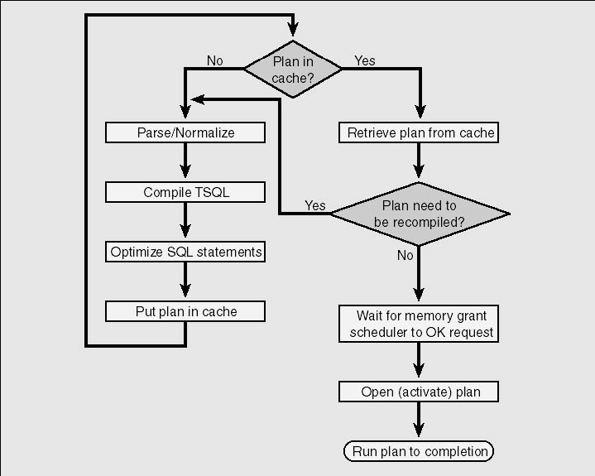
Generating Execution Plans
Figure: The flow of query
compilation and
execution

Slide 49
Memory Grant Scheduler
While Optimizing, the optimizer determines a minimum and maximum memory needed to run.
Minimum amount of memory value is stored with the query plan
While executing the plan, the plan gets passed to a routine called the memory grant scheduler
The plan is passed if the query doesn't have a sort or a hash operation as part of the plan
Very large queries are made to wait till they get their required memory
When a query waits for more than 25 seconds, you get a 8645 Timeout error

Slide 50
Opening the Plan and Executing
Actual Execution happens here
If query is using the default result set model, the plan will run until all rows are produced and sent to the client
If cursor model is used, each client request one block of rows
After each block is sent back to the client, SQL Server waits for the client to request the next block.
While waiting,
  Some of the locks are released
  Some resources are given up
  Some positioning information is squirreled away

Slide 51
End of Topic – Query Processor
?

Slide 52
References
Inside SQL Server 2000 by Kalen Delaney
SQL Server 2000 Books online
http://www.sqlserverperformance.com

Slide 53
End of Topic – Query Processor
Thank you
End of Session
Architecture Components | Storage Concepts | Transaction Logs | Indexes I | Indexes II | Locking I | Locking II | Query Processor

